Slide 1
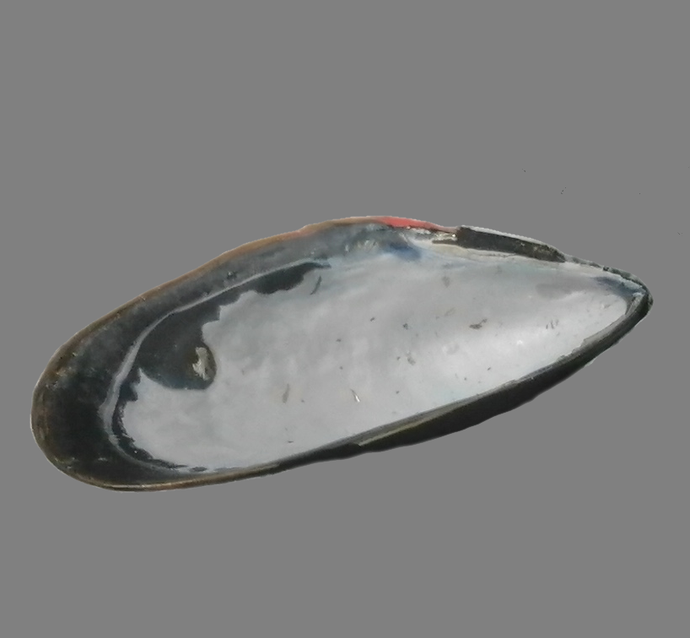
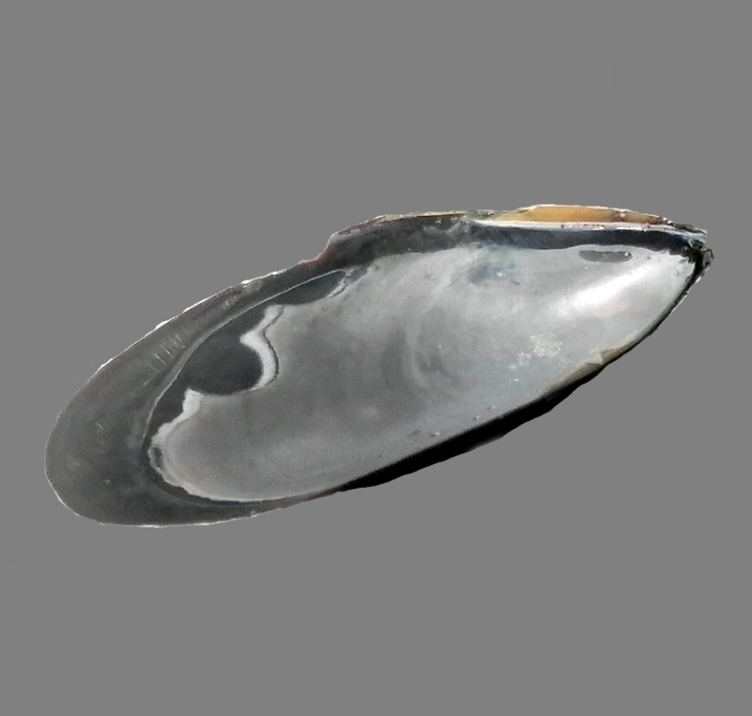
E-morphotype
T-morphotype
Strip of uncovered prismatic
layer

